Slide 1
Calibrating risk perception in patients with hypertension using part-to-whole graphics and social comparison framing
Sean X. Duan, MA
University of Missouri

Slide 2
Relevant Financial Disclosure Sean X. Duan, MA
I have nothing to disclose regarding perceived or actual conflicts of interest.

Slide 3

Acknowledgements
Collaborators:
Victoria A. Shaffer, PhD
David A. Dorr, MD, MS
Shannon M. Canfield, PhD, MPH
Abigail Rolbiecki, PhD, MPH, MSW
Aisha J. Ghumman, MPH
Richelle J. Koopman, MD, MS
Funding
AHRQ: 1R18HS028579-01A1

Slide 4
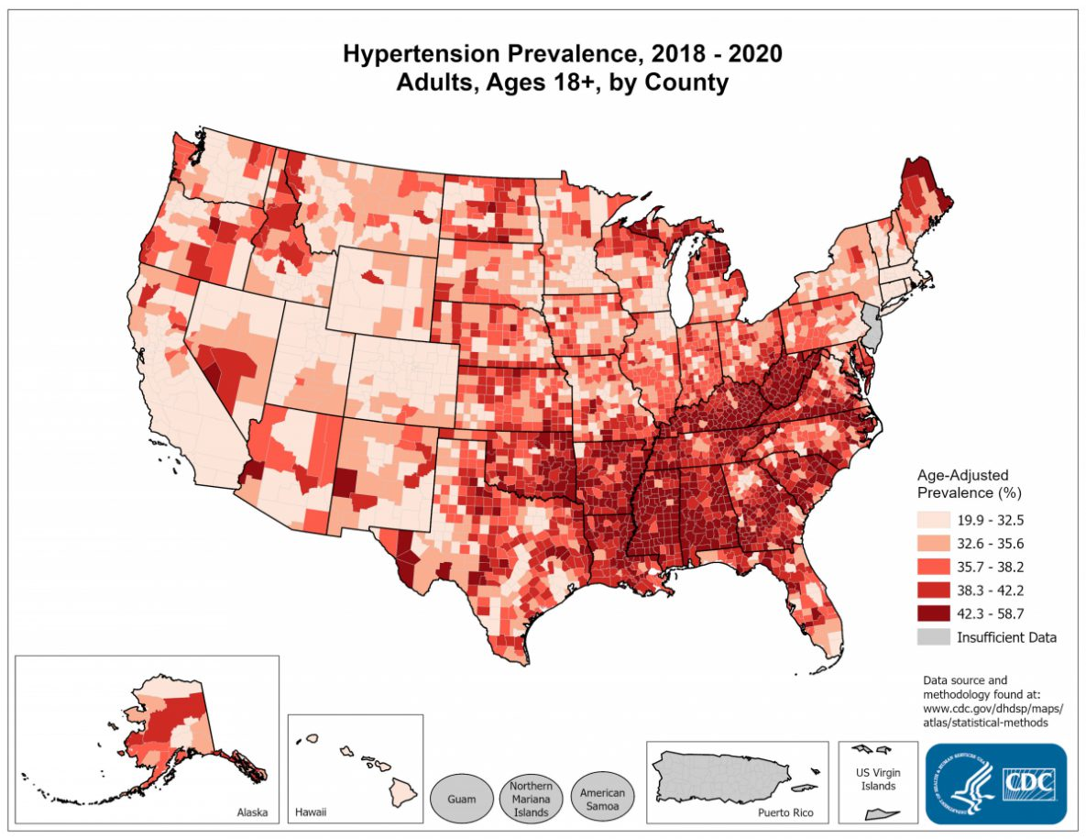
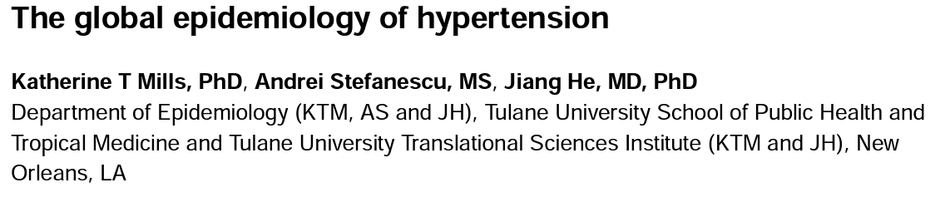

Slide 5
Clinical Uncertainty Graph of Blood Pressure Data
Kerr EA, Zikmund-Fisher BJ, Klamerus ML, Subramanian U, Hogan MM, Hofer TP. The role of clinical uncertainty in treatment decisions for diabetic patients with uncontrolled blood pressure. Ann Intern Med. 2008 May 20;148(10):717-27. doi: 10.7326/0003-4819-148- 10-200805200-00004. PMID: 18490685.

Slide 6
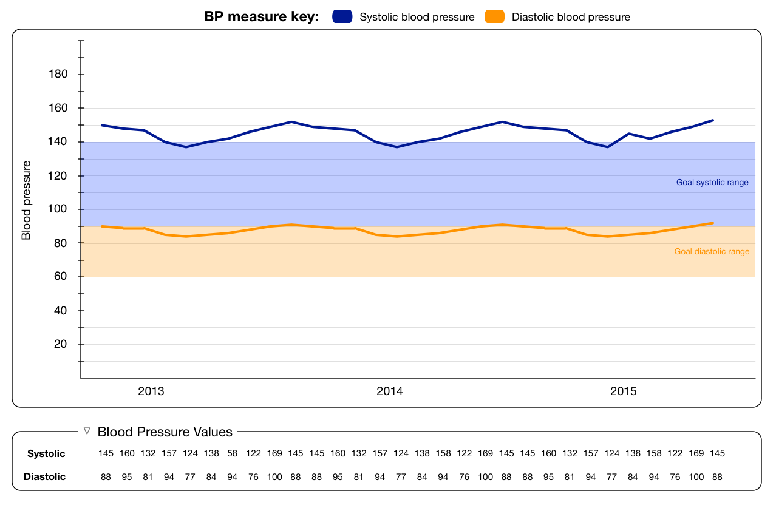
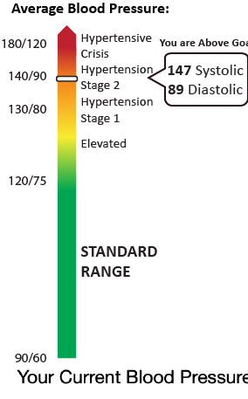
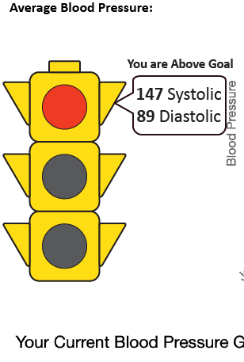
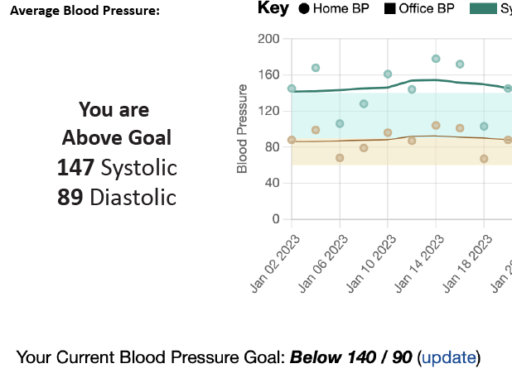
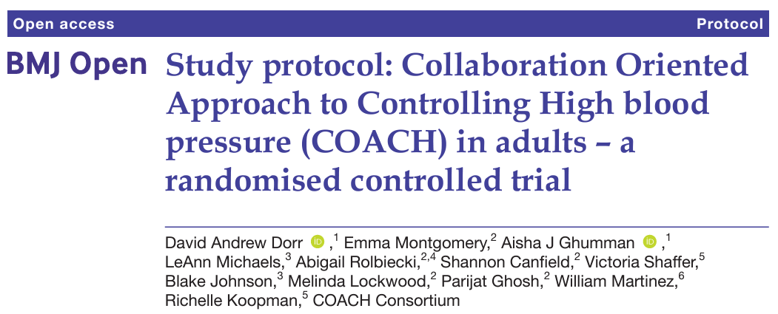
Prior Work

Slide 7
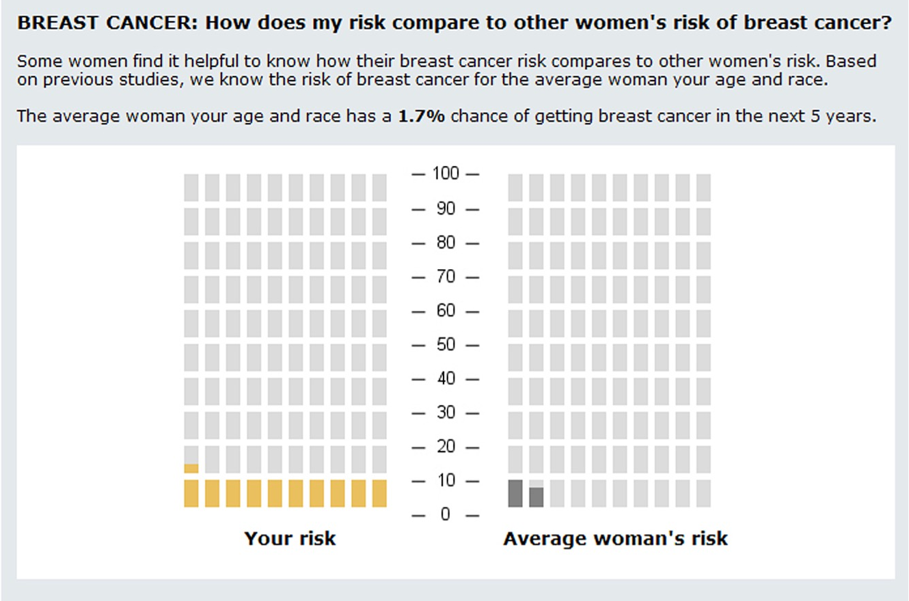
How does social comparison affect risk perception and behavior?
Dillard AJ, Ubel PA, Smith DM, Zikmund-Fisher BJ, Nair V, Derry HA, Zhang A, Pitsch RK, Alford SH, McClure JB, Fagerlin A. The distinct role of comparative risk perceptions in a breast cancer prevention program. Ann Behav Med. 2011 Oct;42(2):262-8. doi: 10.1007/s12160-011-9287-8. PMID: 21698518; PMCID: PMC3760792.

Slide 8
Study 1 Method
Repeated measures within-subjects design
2 Independent Variables
Systolic BP mean (130, 145, and 160 mmHg)
Risk communication strategy
No risk info (control)
Verbal description of risk
Social comparing (e.g., at or above average risk)
3 x 3 Design
Patients viewed and rated our measures on all 9 displays
Measured graph literacy and health literacy

Slide 9
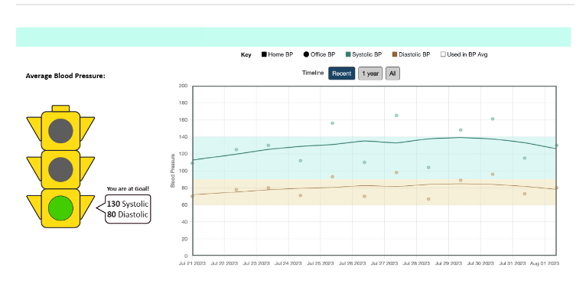
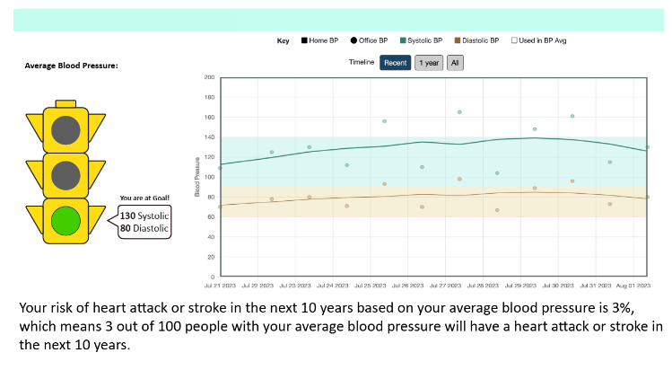
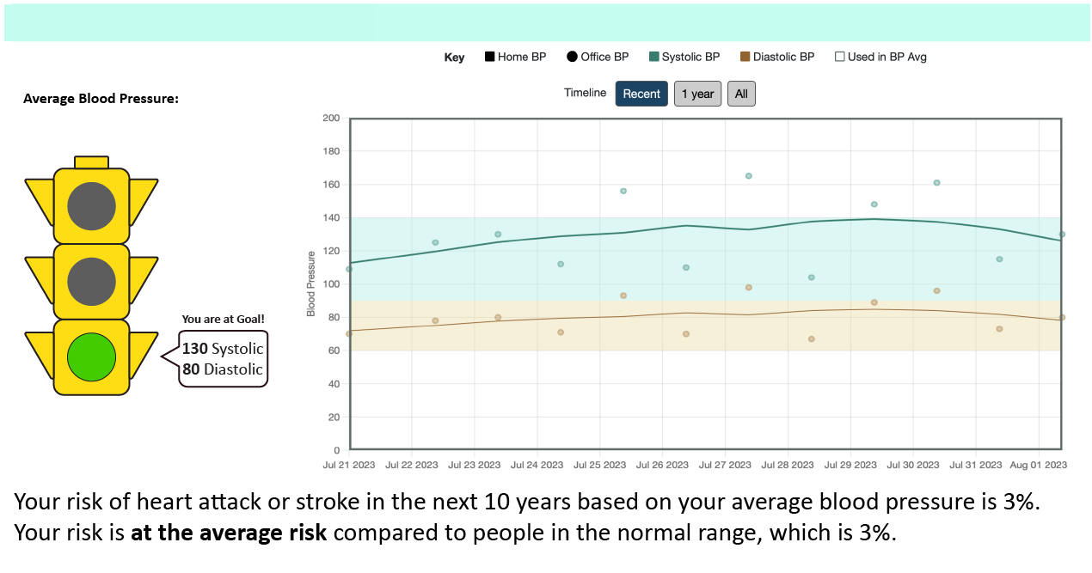
Control
Verbal Description
Social Comparison
Kawada T. Reynolds risk score as a risk assessment tool for cardiovascular disease after 10 years: its strong relationship with blood pressure. J Clin Hypertens (Greenwich). 2012 Aug;14(8):571-2. doi: 10.1111/j.1751-7176.2012.00644.x. Epub 2012 May 3. PMID: 22863168; PMCID: PMC8108792.

Slide 10
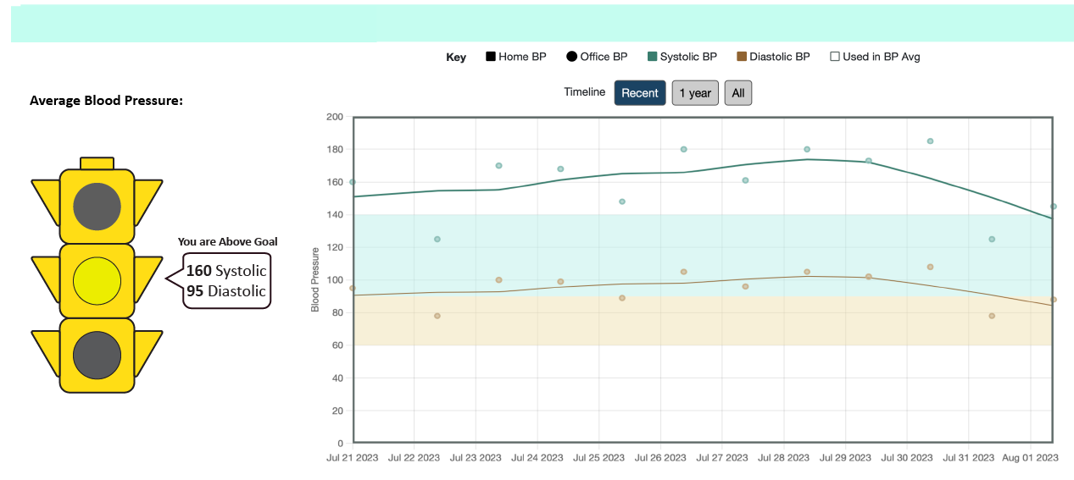
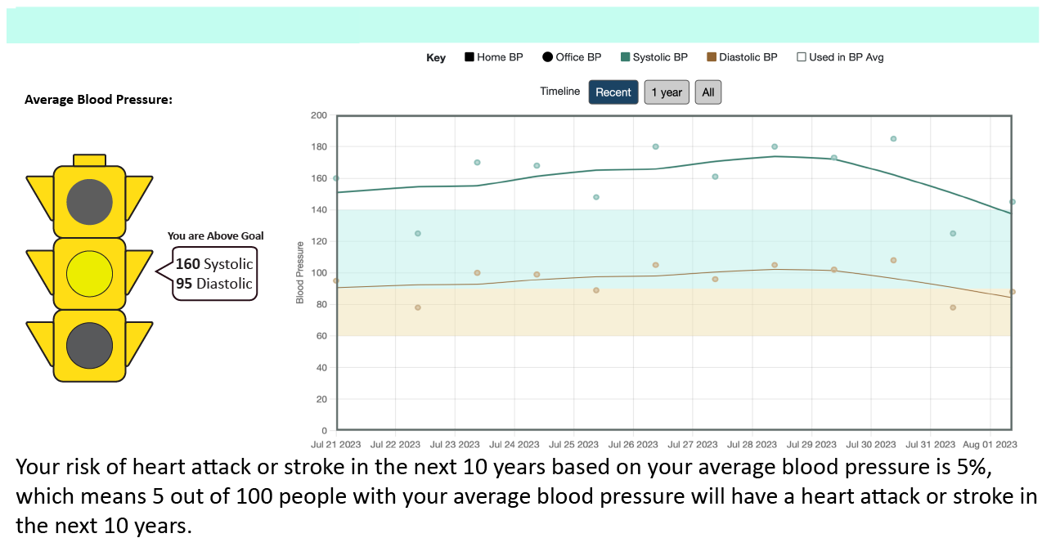
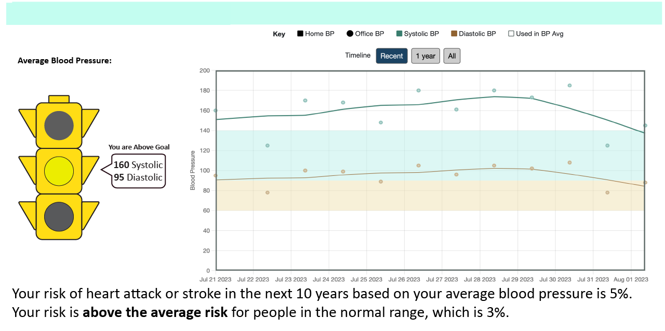
Control
Verbal Description
Social Comparison
Kawada T. Reynolds risk score as a risk assessment tool for cardiovascular disease after 10 years: its strong relationship with blood pressure. J Clin Hypertens (Greenwich). 2012 Aug;14(8):571-2. doi: 10.1111/j.1751-7176.2012.00644.x. Epub 2012 May 3. PMID: 22863168; PMCID: PMC8108792.

Slide 11
Study 1 Results - Participants
Patients w/ Hypertension (N = 100)
Age M (SD): 69.55 (10.44)
Female % (n): 78 (80)
White % (n): 83 (94)
Education % (n):
High school or less: 22.3% (25)
Some College: 23.2% (26)
College or Technical degree: 41.1% (46)
Graduate or professional degree: 13.4% (15)

Slide 12

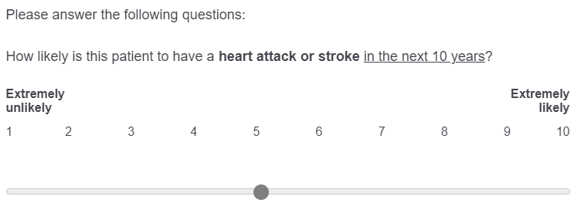
Study 1 Measure - Risk Perception

Slide 13
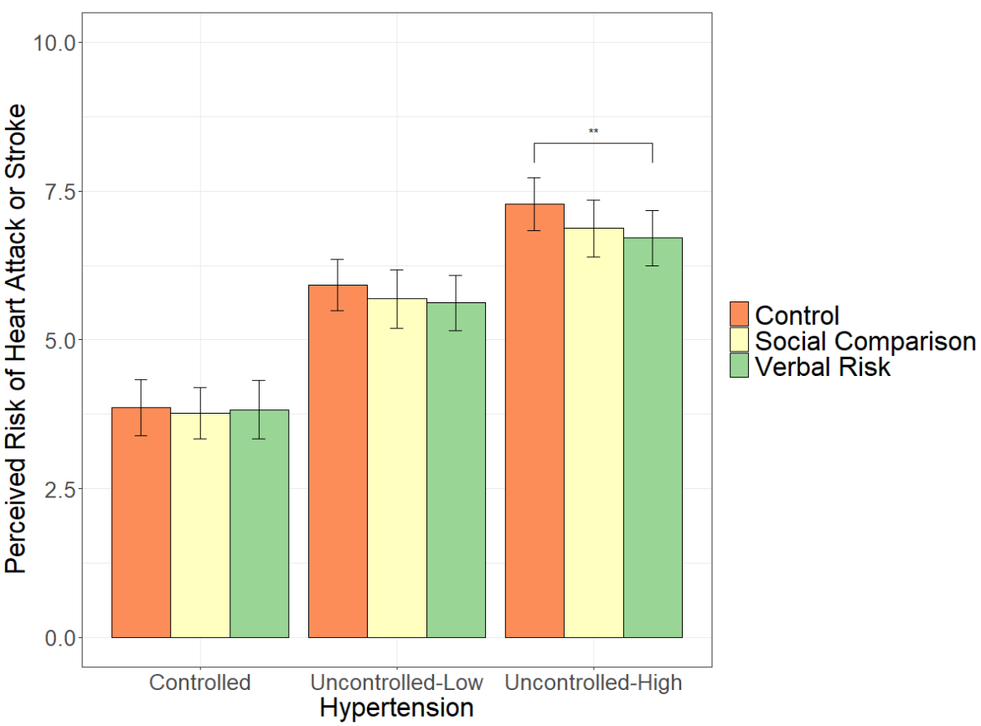
Study 1 Results - Risk Perception
F (4, 99) = 3.553, p < 0.05

Slide 14
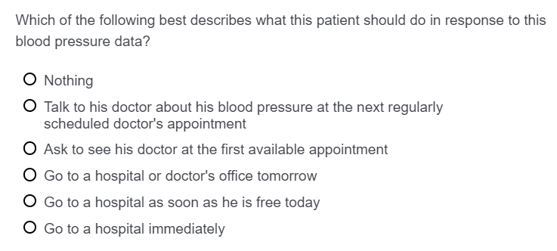
Study 1 Measure - Preferred Response

Slide 15
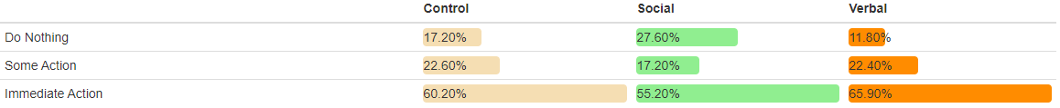
Study 1 Preferred Responses for High Uncontrolled Hypertension (160)
X² (4, N = 100) = 7.503, p = .112

Slide 16
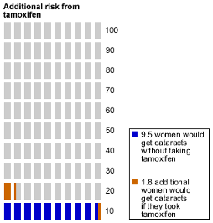
How do ‘part-to-whole’ graphics affect risk perception and behavior? (in judgements of hypertension?)
Zikmund-Fisher BJ, Ubel PA, Smith DM, Derry HA, McClure JB, Stark A, Pitsch RK, Fagerlin A. Communicating side effect risks in a tamoxifen prophylaxis decision aid: the debiasing influence of pictographs. Patient Educ Couns. 2008 Nov;73(2):209-14. doi: 10.1016/j.pec.2008.05.010. PMID: 18602242; PMCID: PMC2649664.

Slide 17
Method Study 2 Design
Repeated measures within-subjects design
2 Independent Variables
Systolic BP mean (130, 145, or 160 mmHg)
Risk communication strategy
Verbal description of risk
Icon Array
Horizontal Bar Graph
3 x 3 Design
Patients viewed and rated our measures on all 9 displays
Measured graph literacy and health literacy

Slide 18
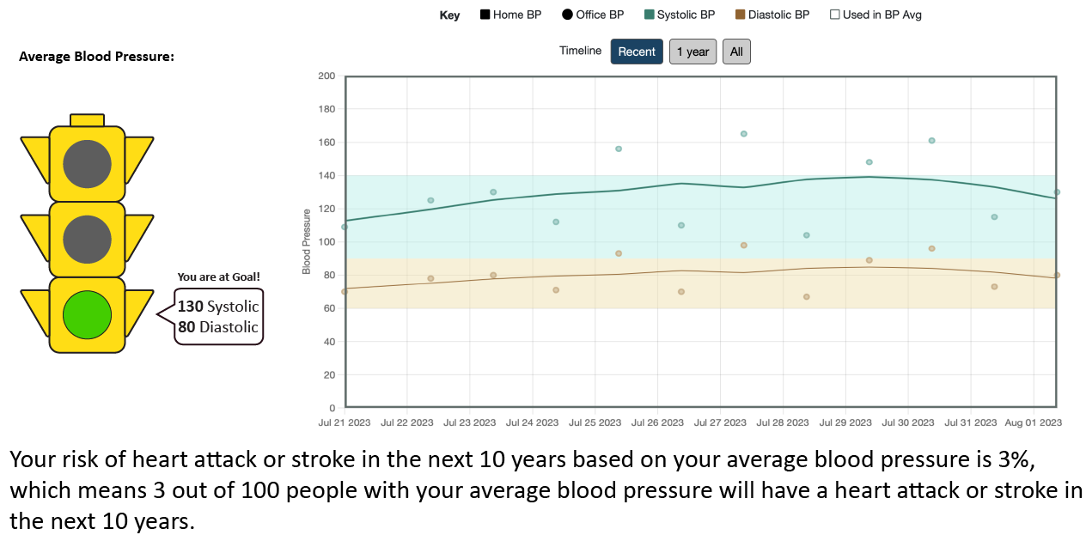
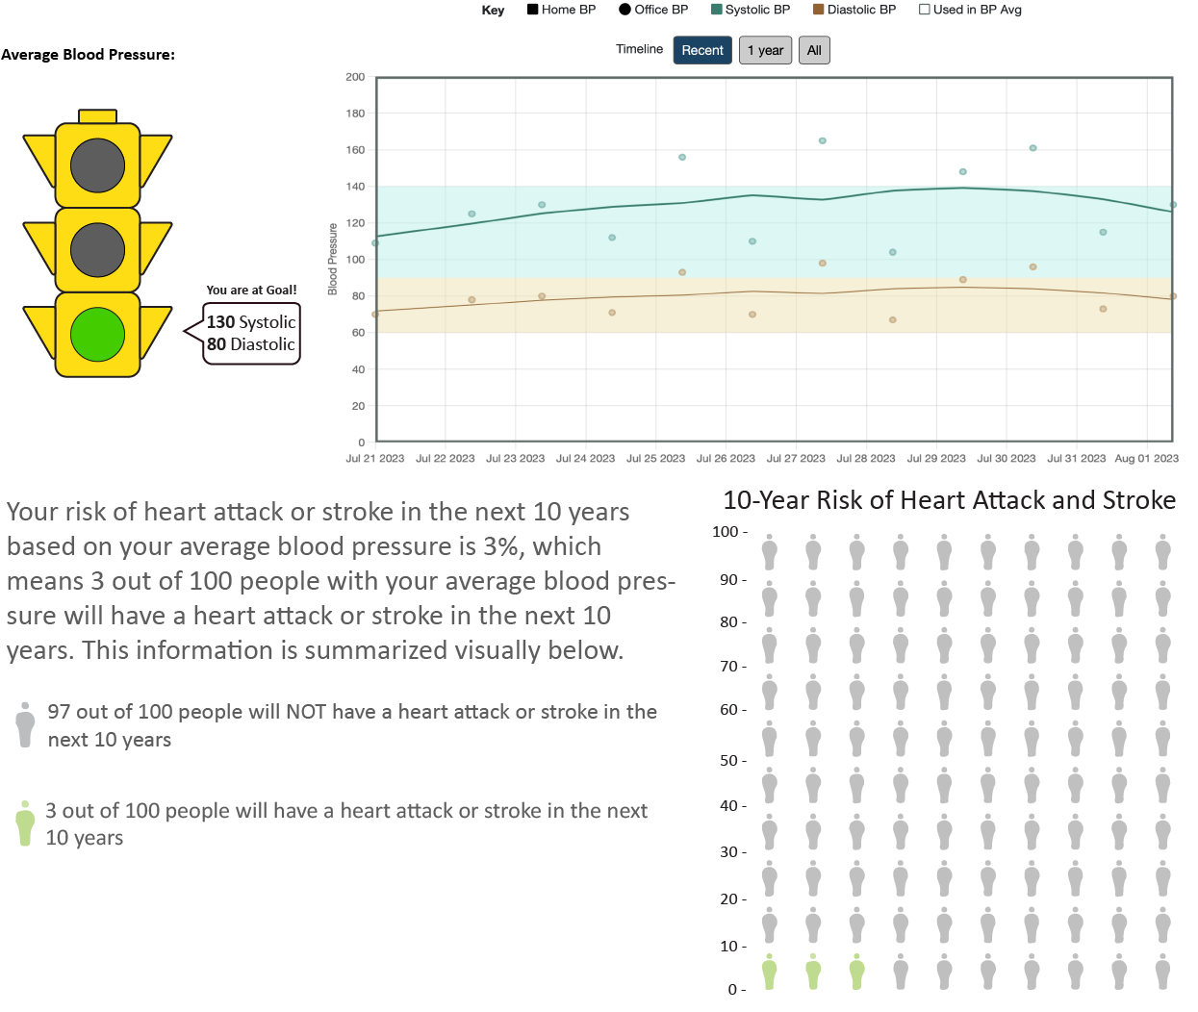
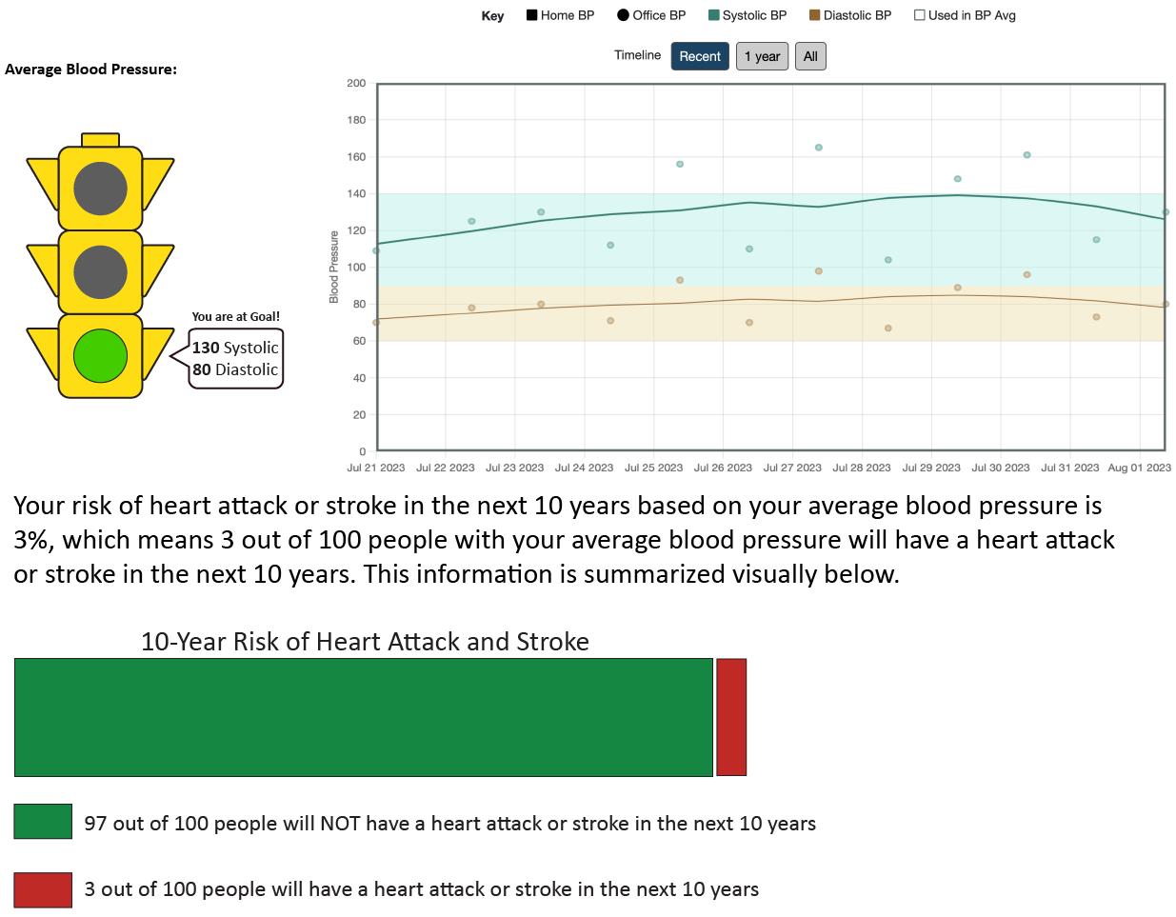
Verbal Description
Icon Array
Horizontal Bar

Slide 19

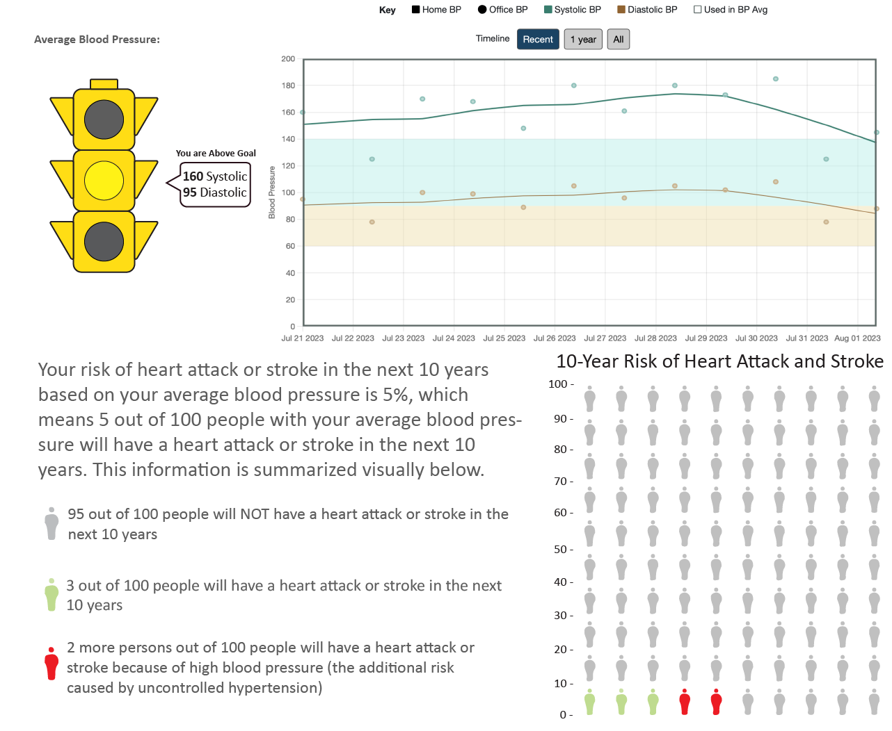
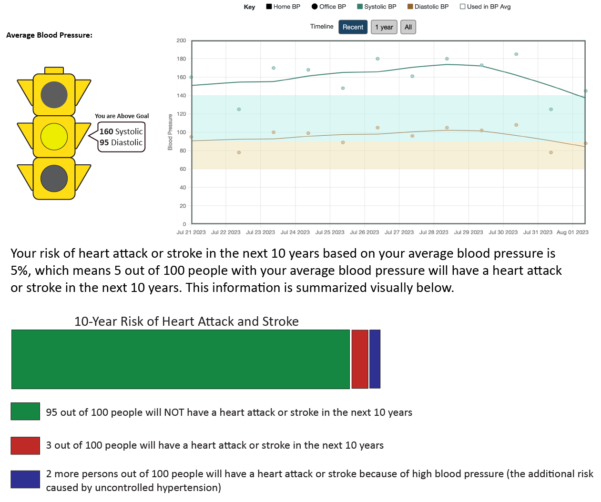
Verbal Description
Icon Array
Horizontal Bar

Slide 20
Method Participants – Study 2
Patients w/ Hypertension (N = 110)
Age M (SD): 61.25 (13.18)
Female % (n): 78.7 (85)
White % (n): 85.2 (92)
Education % (n):
High school or less: 36.1% (39)
Some College: 15.7% (17)
College or Technical degree: 36.1% (39)
Graduate or professional degree: 12.0% (13)

Slide 21
Method Risk Perception

Slide 22
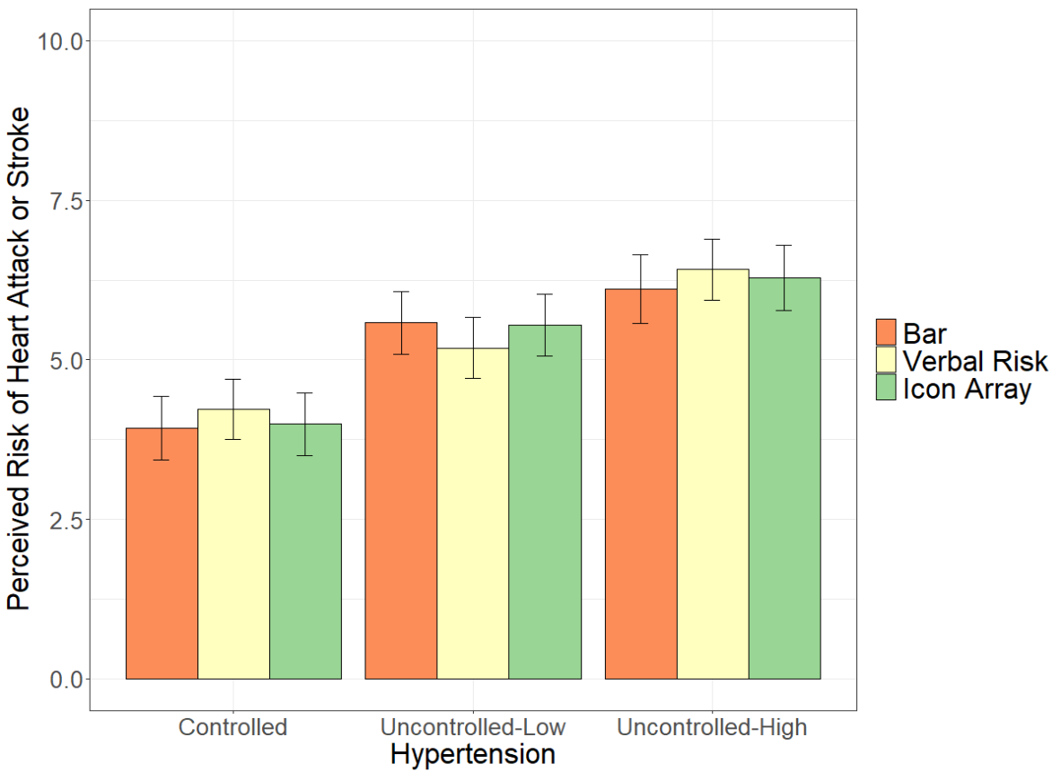
Results Risk Perception
F (4, 106) = 0.828, p = ns

Slide 23
Method Preferred Response

Slide 24
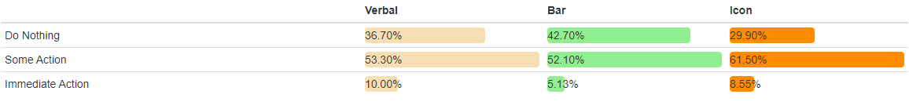
Study 2 Preferred Responses for High Uncontrolled Hypertension (160)
X² (4, N = 110) = 5.613 p = .23

Slide 25
Discussion
Risk perception and preferred response sensitive to mean BP
Risk of heart attack and stroke appropriately increases as mean BP increases
Likelihood of action increases as mean BP increases
Risk information = more accurate (but lower) risk perception for uncontrolled hypertension
May lead to less action
Positive if fewer ED visits
Negative if it leads to doing nothing

Slide 26

Control
Social Comparison
Verbal Risk

